Slide 1



PERSONALITY PREDICTION using (MBTI)
Myers-Briggs Personality Type Dataset
A presentation by STANDARD SCALER
HDSC Winter 2022 Capstone Project
April 30, 2022

Slide 2


Vanessa Onyema
Role: Presenter 1
Chigozie Udoh
Role: Presenter 2

Slide 3
Introduction
Self report inventory created to identify personality type, strengths. It was created by Isabel Myers and her mother Katherine Briggs based on their work with Carl Jung’s theory of personality types
This MBTI inventory is the most widely used psychological instruments in the world
Based on answers to questions, people are identified as having one of 16 personality types. It is made up of four different scales:
Extraversion (E) – Introversion (I)
Sensing (S) – Intuition (N)
Thinking (T) – Feeling (F)
Judging (J) – Perceiving (P)
The goal of the MBTI is to allow respondents to further explore and understand their own personalities including their likes, dislikes, strengths, weaknesses, possible career preferences, and compatibility with other people.

Slide 4
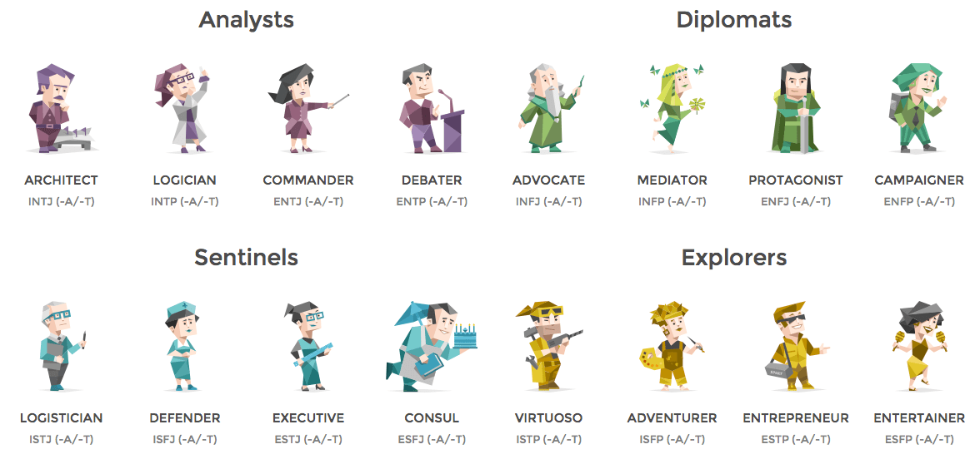
Overview of the 16 personality types

Slide 5
Problem Statement
How can we accurately predict Myers-Briggs Personality type using NLP (Natural Language Processing)

Slide 6
Existing Solutions
Sentiment Analysis
Named Entity Recognition
Text summarization
Topic Modeling
Text Classification
Keyword extraction
Lemmatization and Stemming
Tokenization
Parsing
Sentence Segmentation

Slide 7
Dataset Description and Approach
Our approach
Data Collection
Data Cleaning/ Text Preparation
Identifying missing values (found none)
Ensuring Consistency of the personality classes
Ensuring correct data type for the columns
Link removal
Removal of mentions
Replacement of emojis and emoticons with their meanings
Stop word removal
Removal of numbers longer than 1 character
Removal of Symbols except the apostrophe(‘) and the vertical slash(|).
EDA and Feature creation on cleaned text
Preparation of cleaned text towards Modelling.
Tokenization using Lemmatization with Pos (Parts of Speech) Tagging.
Vectorization using TF-IDF
Using Label encoder on the Target Variable
Modelling
Model Deployment

Slide 8
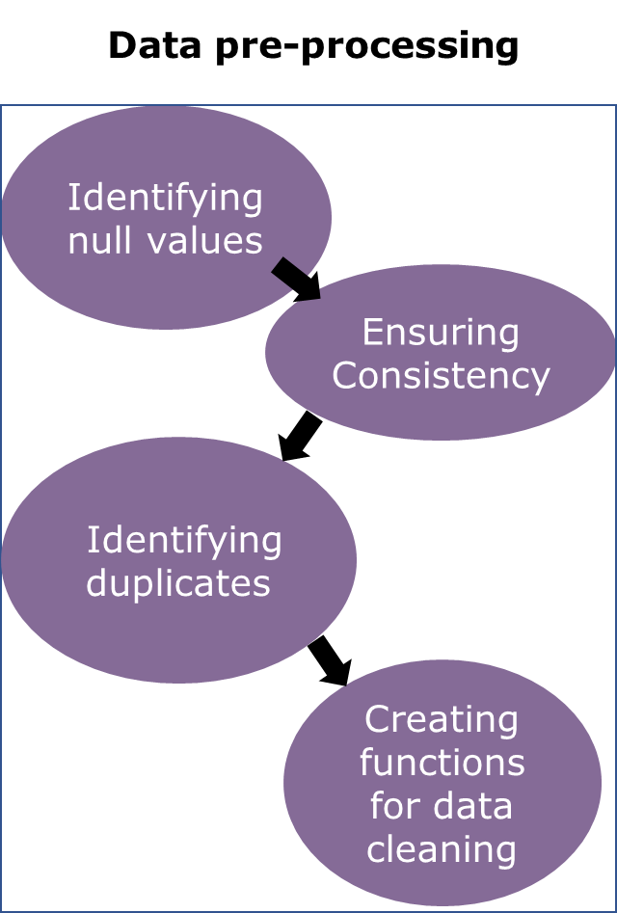
Dataset Description and Approach
Data Collection
Modeling
Personality Cafe
EDA and feature creation
Data training and testing
Kaggle
Model creation
Model deployment

Slide 9
Dataset Description and Approach
Defining KEYWORDS
Lemmatization is the grouping together of different forms of the same word.
Text summarization Definition and Intuition to solving our problem
Text summarization is the process of creating a short, coherent, and fluent summary of a longer text document and involves the outlining of the text’s major points.
Text identification, interpretation and summary generation, and analysis of the generated summary are some of the key challenges faced in the process of text summarization. The critical tasks in extraction-based summarization are identifying key phrases in the document and using them to discover relevant information to be included in the summary.
Some other advantages of Text Summarization include:
Saves Time:
By generating automatic summaries, text summarization helps content editors save time and effort, which otherwise is invested in creating summaries of articles manually.
Instant Response:
It reduces the user’s effort involved in exacting the relevant information. With automatic text summarization, the user can summarise an article in just a few seconds by using the software, thereby decreasing their reading time.
An intuition we had on text summarization and our project is that for example two people could be saying the same thing and with text summarization and with a technique like lemmatization we could be able to figure that out, vectorize to get features and train a model.

Slide 10
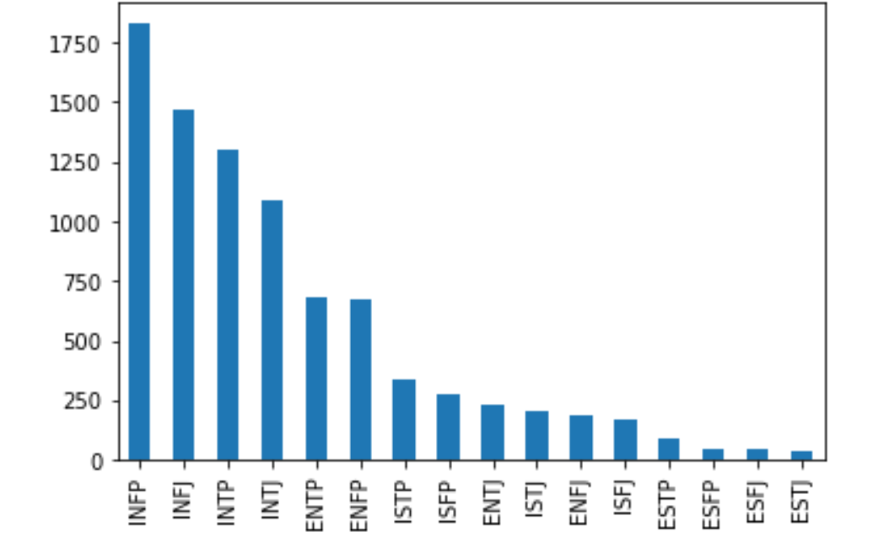
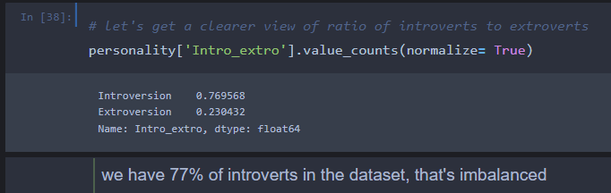
EDA
A view of the distribution of the 16 personalities.
Percentage of Introverts and extroverts in the dataset

Slide 11
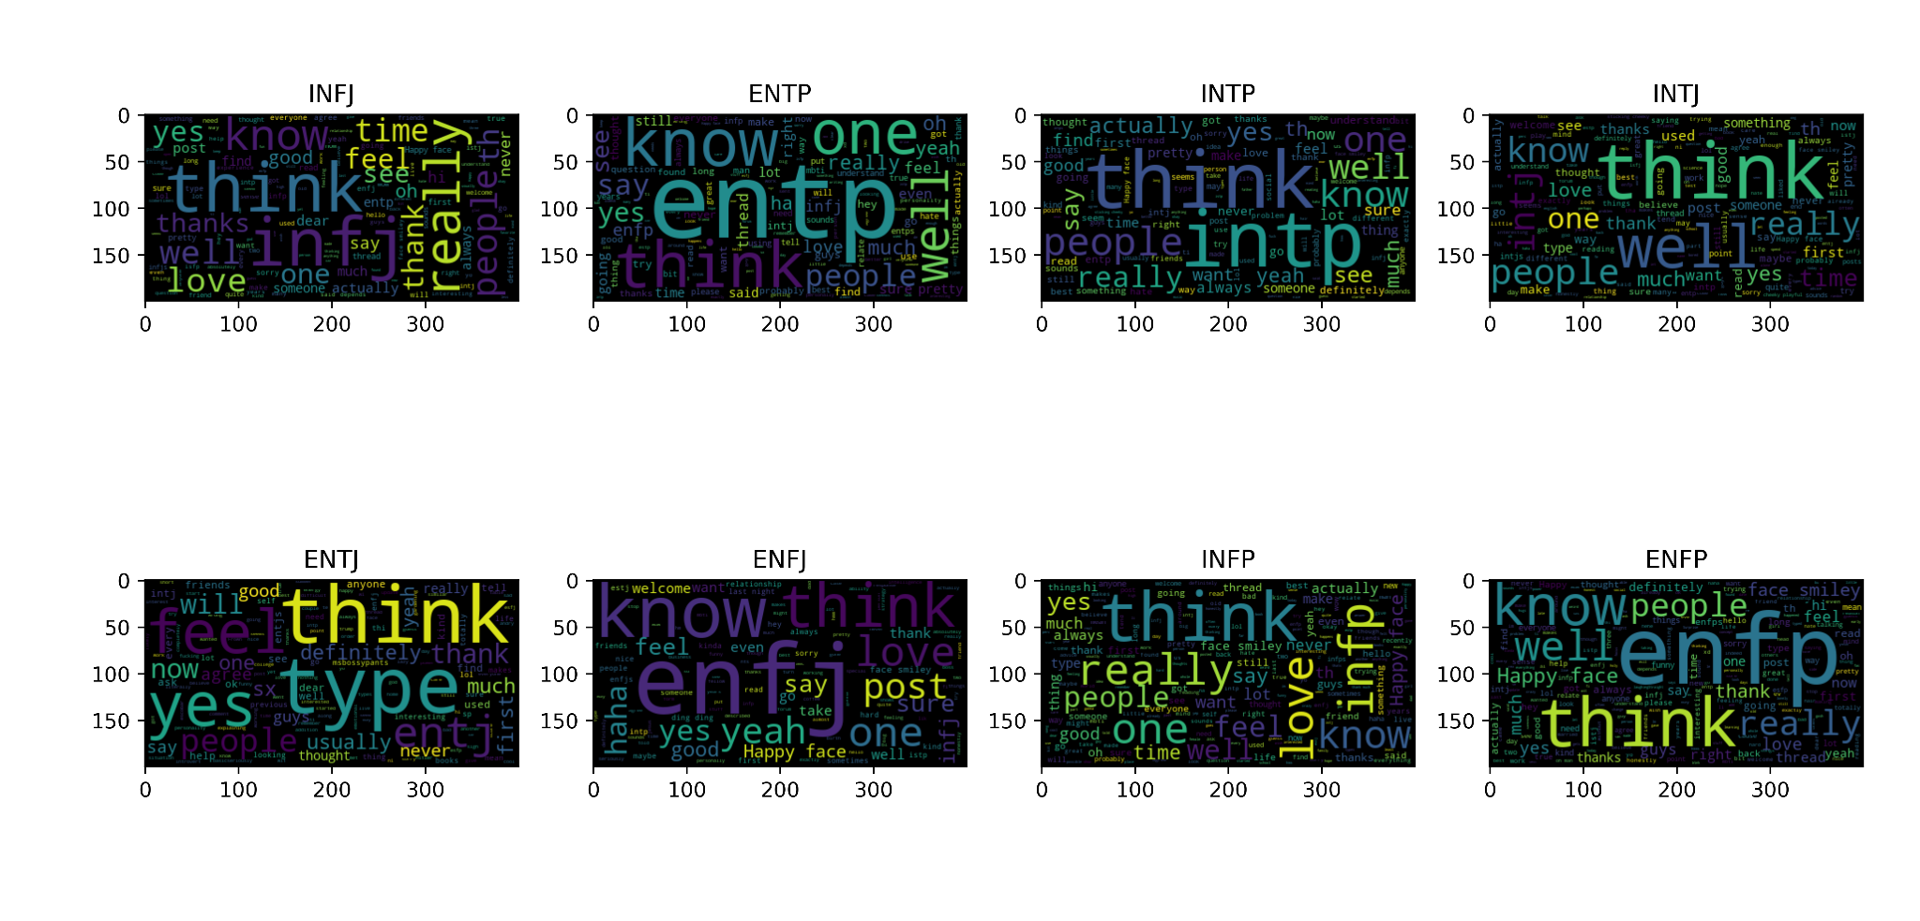
EDA
A word plot on the different personalities after data had been cleaned. One thing to observe is that these personalities seem to have talked about themselves a lot.

Slide 12
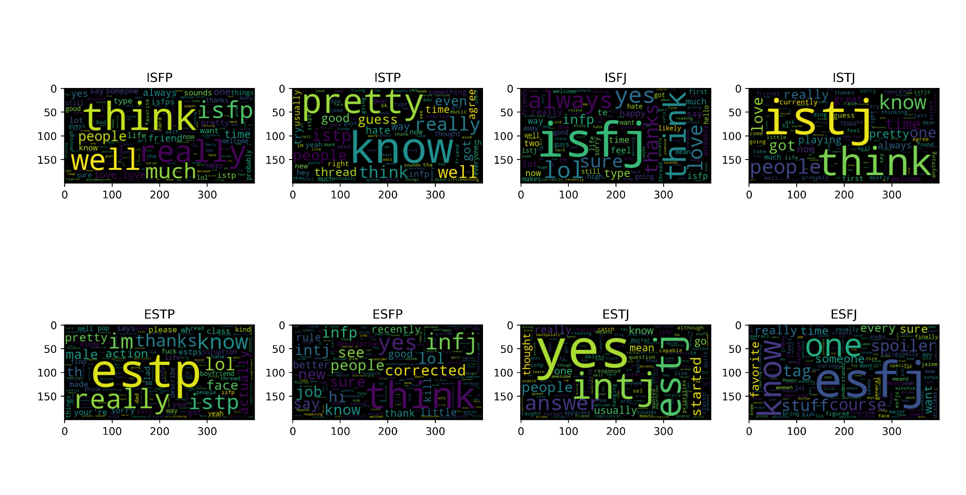
EDA

Slide 13
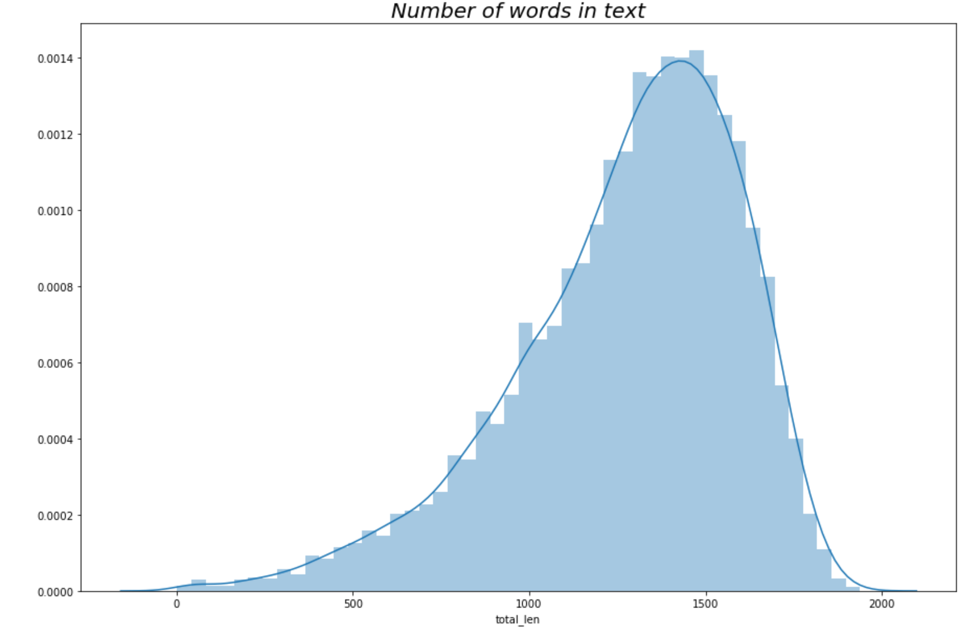
EDA

Slide 14
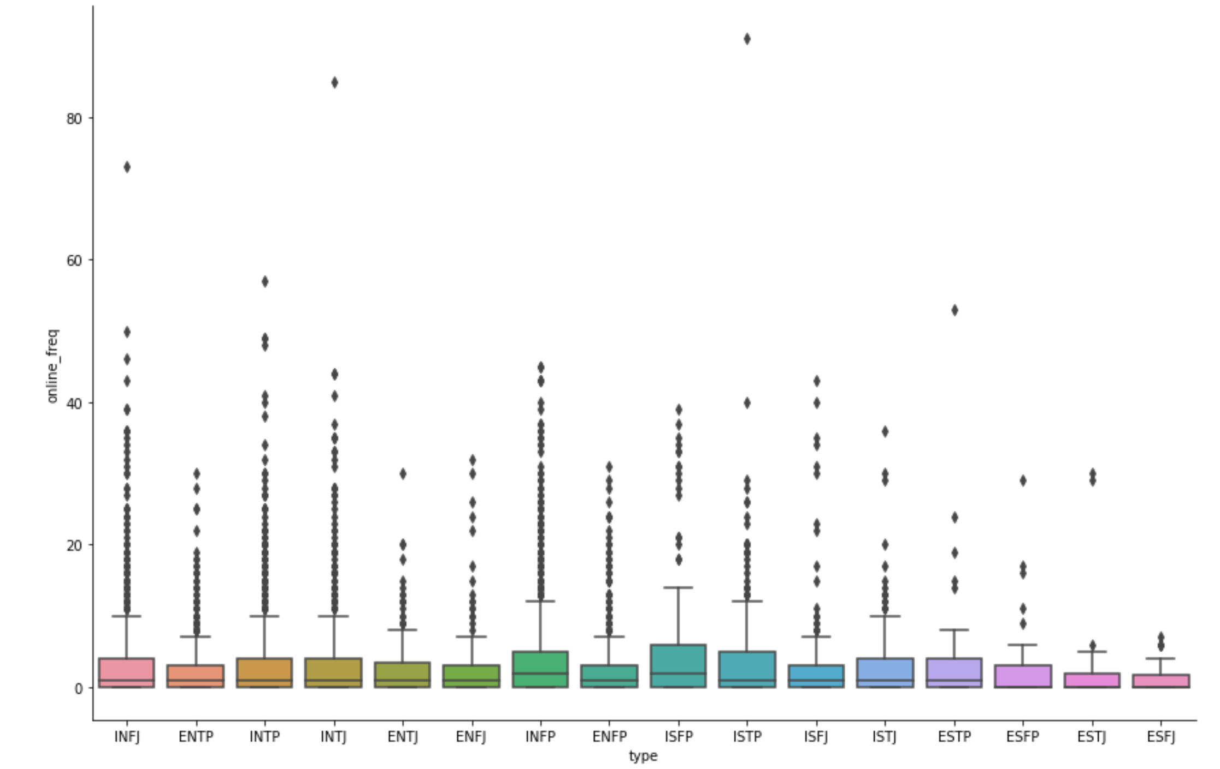
Feature Creation and EDA
We had hypothesized that introverts had more online presence than extroverts which is also visible from the imbalance in the dataset. We then created a feature showing number of links shared to see if that showed us something.

Slide 15
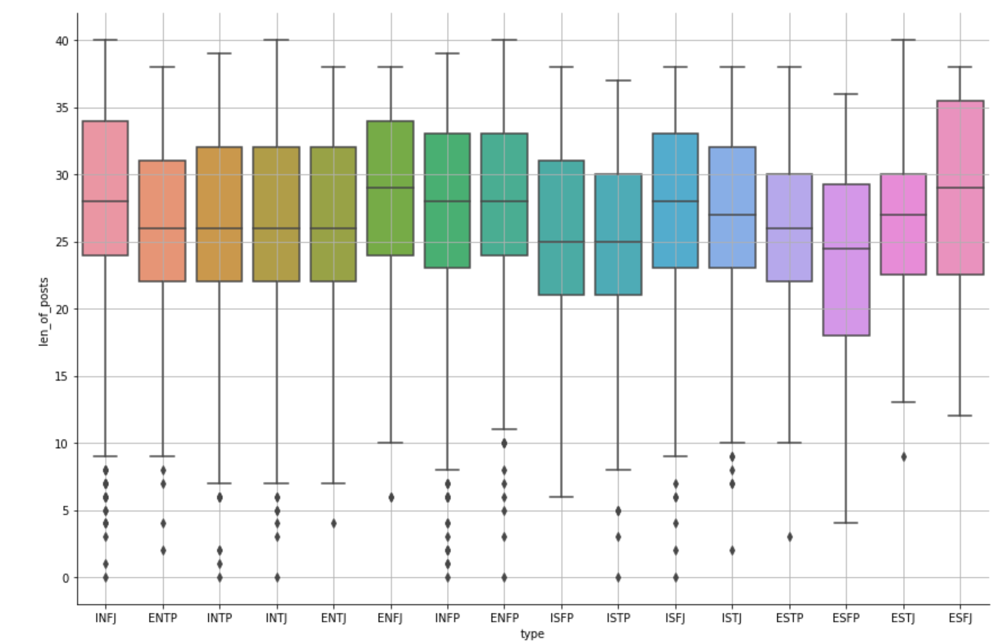
Feature Creation and EDA
We had also hypothesized that maybe some group posted longer texts than others so we created a feature that takes the average of the 25th and 75th percentile of length of the supposed 50 texts from each person.

Slide 16
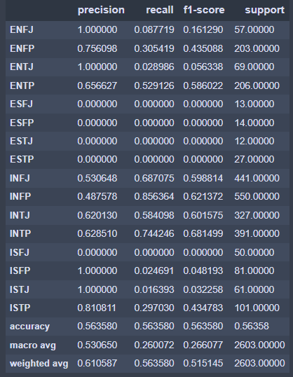
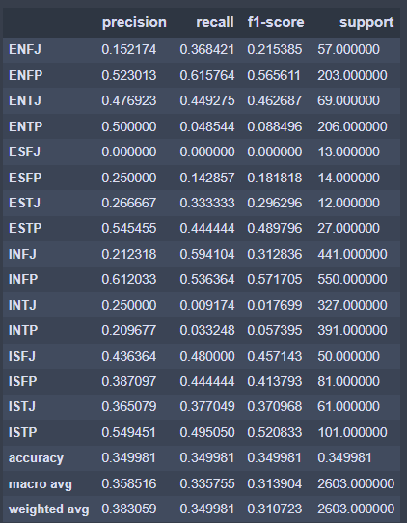
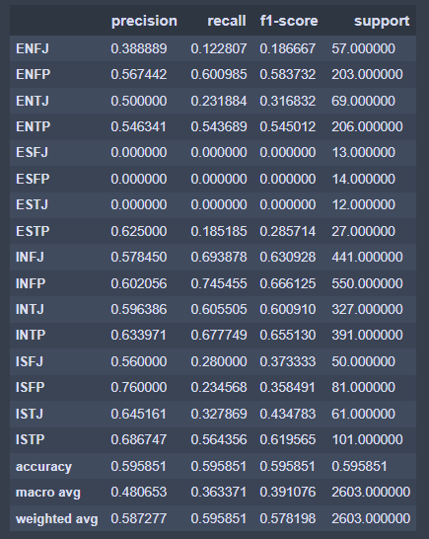
Model
We started by splitting the data using train_test_split using the stratify parameter hence maintaining the imbalance class distribution.
Selected metric
F1_MACRO
Pre Tuning.
RANDOM FOREST
ADABOOST
BAGGINGCLASSIFIER
F1-Macro: 26.61%
F1-Macro: 31.30%
F1-Macro: 39.11%

Slide 17
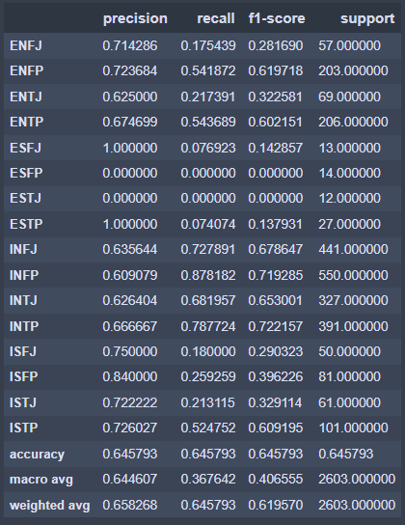
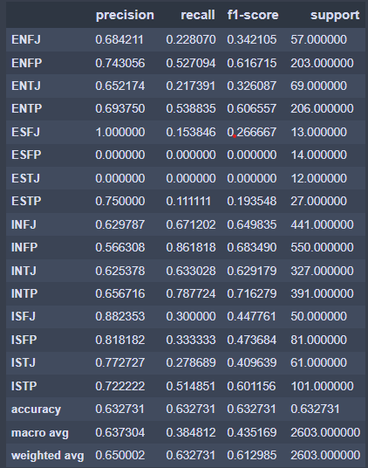
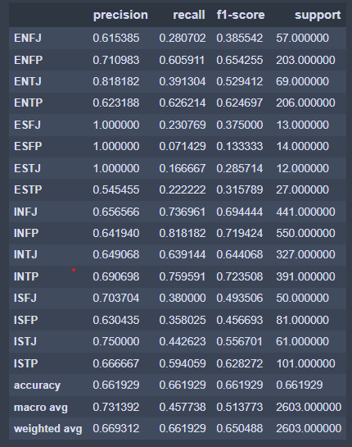
Model
Selected metric
F1_MACRO
Pre Tuning.
LOGISTIC REGRESSION
SUPPORT VECTOR MACHINE
XGBCLASSIFIER
F1-Macro: 40.66%
F1-Macro: 43.52%
F1-Macro: 51.38%%

Slide 18
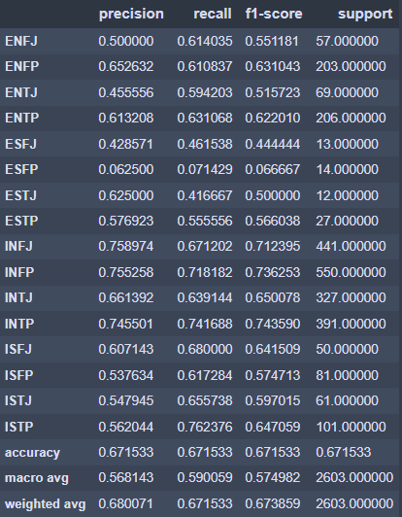
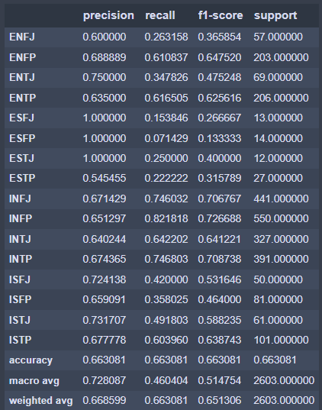
Post Tuning Results.
LOGISTIC REGRESSION
XGBCLASSIFIER.
Accuracy: 67.15%
F1_macro: 57.50%
Accuracy: 66.31%
F1_macro: 51.48%

Slide 19
Summary
A division of several classes of people into 16 distinct personality types across 4 axis based on the Myers Briggs Type Indicator is illustrated as Introversion (I) – Extroversion (E), Intuition (N) – Sensing (S), Thinking (T) – Feeling (F), Judging (J) – Perceiving (P).
The dataset has over 8600 rows of data and on each row we have a person’s type which is his/her 4 letter MBTI code type and also a section of each of the last 50 things posted by them.
Data Cleaning - to clean the text data to make it more understandable and to gain more insights from dataset.
Performing EDA to understand data visually.
Splitting Dataset into train and test. Modelling - selecting best model suitable amongst XGBoost, Logistic Regression, ADABoost, Random Forest.
Logistic regression and XGBoost had the best accuracy after tuning.

Slide 20
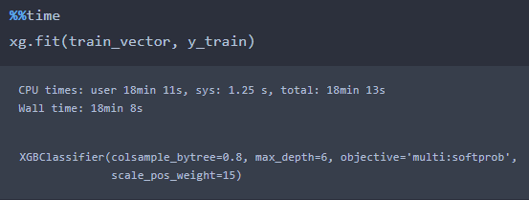
Drawbacks:
Long training time of xgboost. This affected our hyperparameter tuning, so we weren’t able to get the best performing model for our case. As seen below we have about 18 minutes train time for the model.
Future Goals:
For this NLP task we look forward to creating our features using 2 grams and 3 grams, removing rare words and also trying techniques like chunking which forms sequences of tokens based on parts of speech, using rule-based models or collocation which basically relies on the concept of useful phrases.

Slide 21
Thank you!

